Slide 1
Basic electronics
Components
How do they look
What do they do
  Hydraulic/pneumatic analogies
  Common uses
Anne Jan Brouwer 2013
Technologia Incognita

Slide 2
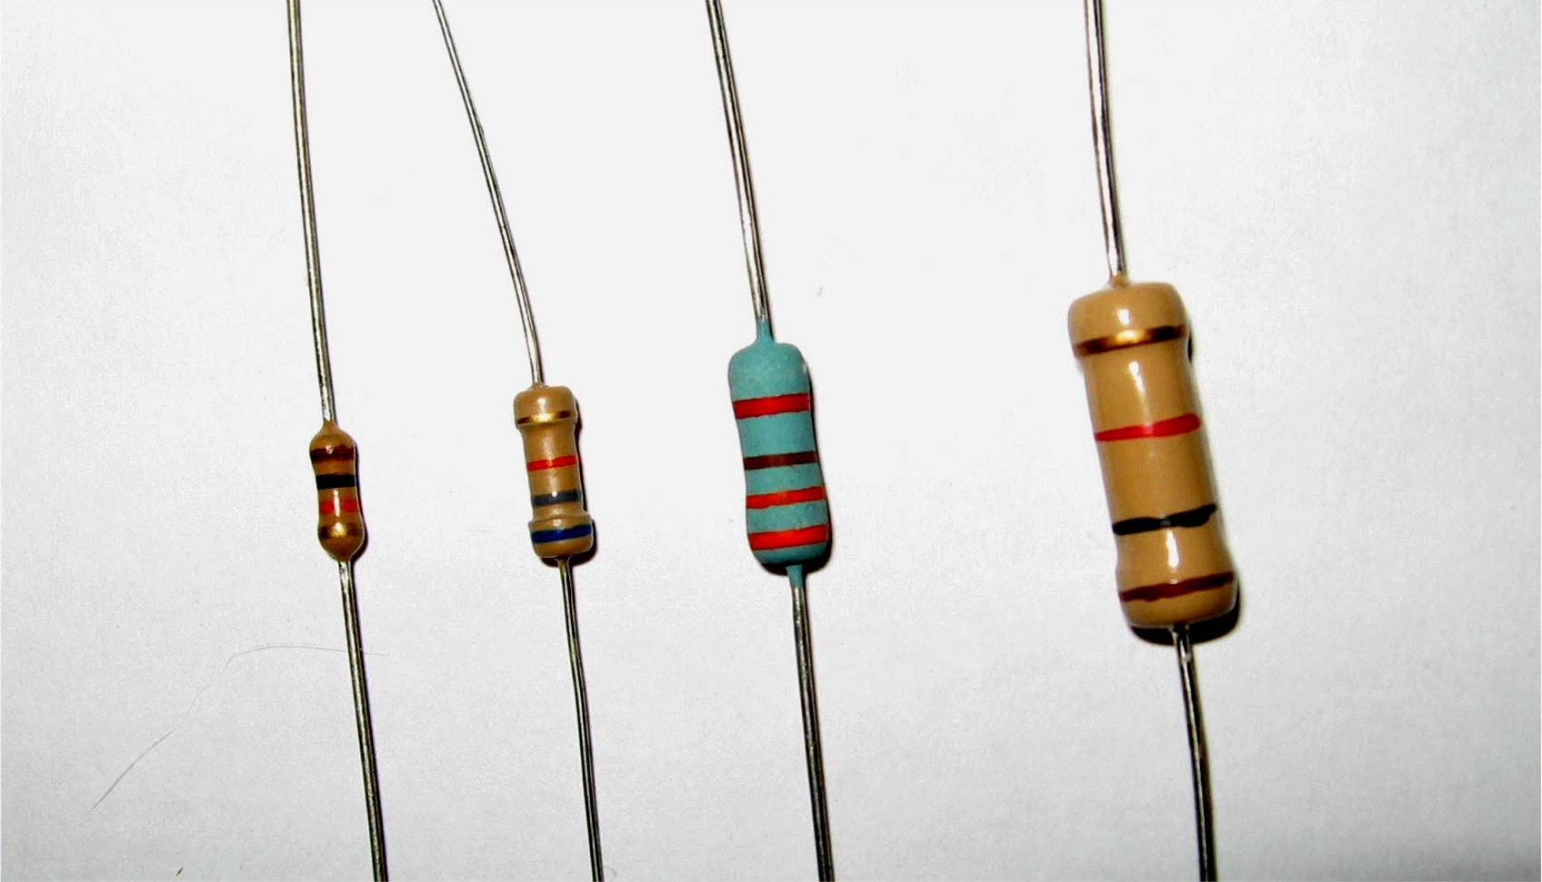
Resistor
http://sonnywalton.com/

Slide 3
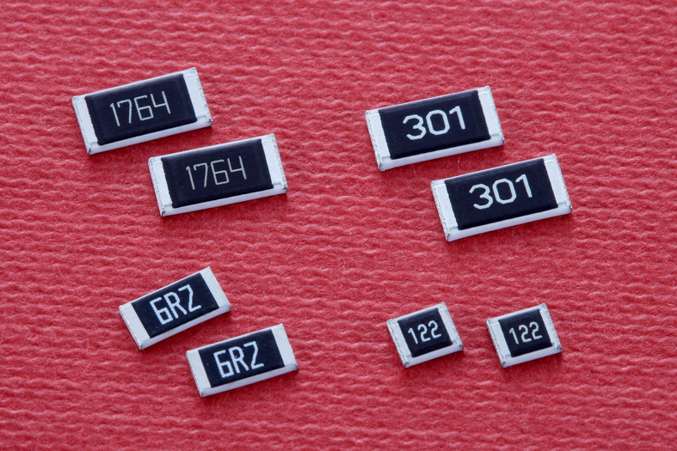
Resistor
http://eeweb.com/

Slide 4
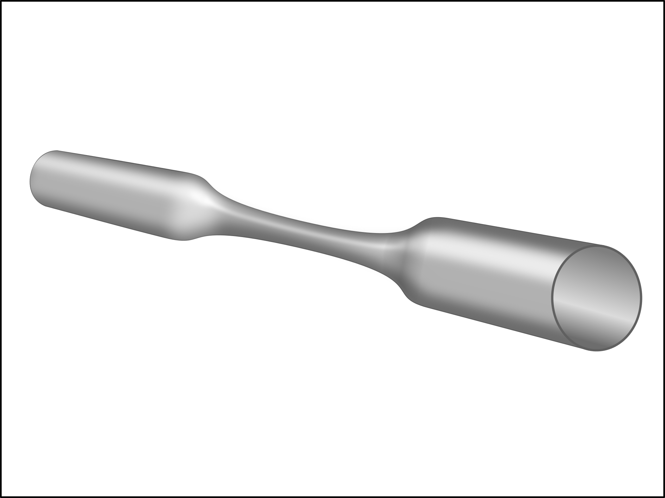
Resistor
http://digitalaudioconcepts.com/

Slide 5
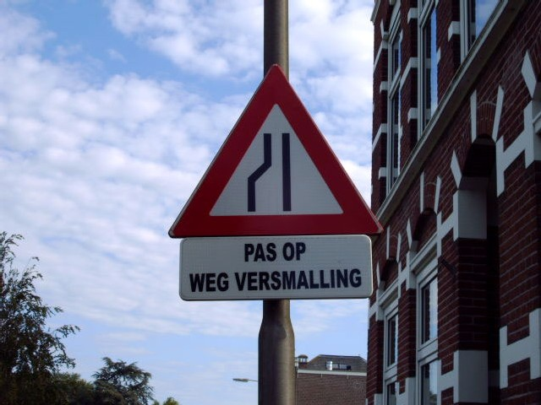
Resistor
http://www.spatiegebruik.nl/

Slide 6
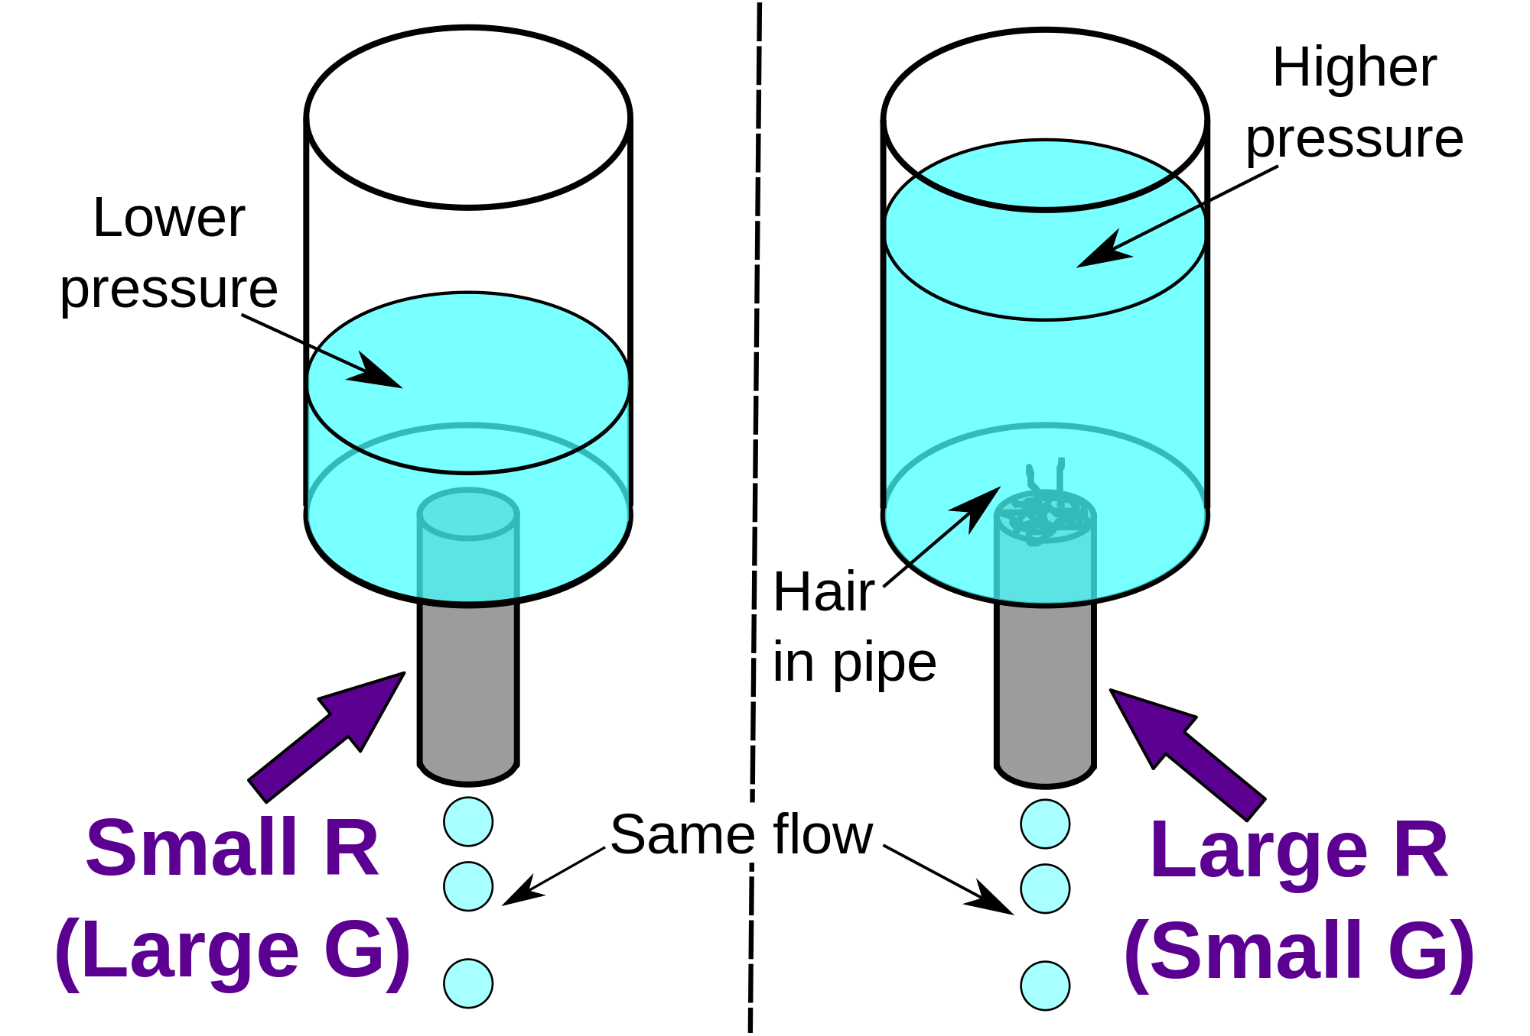
Resistor
http://en.wikipedia.org/wiki/User:Sbyrnes321

Slide 7
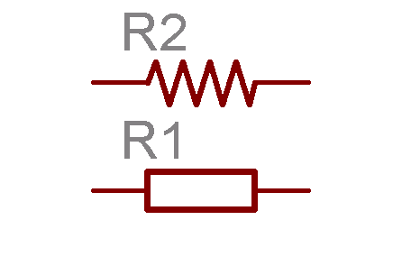
Resistor
http://gaussmarkov.net/

Slide 8
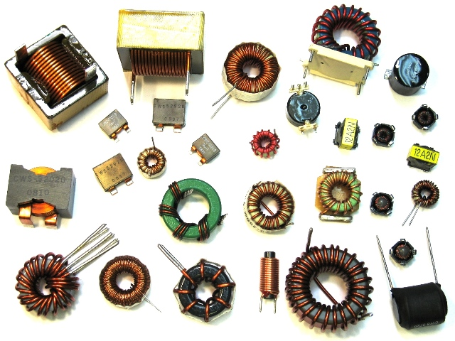
Inductor
http://e101.webs.com/inductors.htm

Slide 9
Inductor
http://en.wikipedia.org/wiki/User:Jocajo

Slide 10
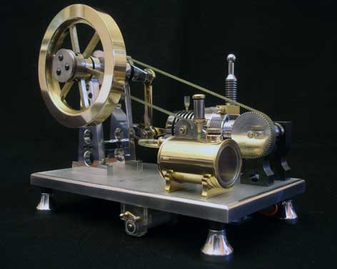
Inductor
http://ridders.nu/

Slide 11
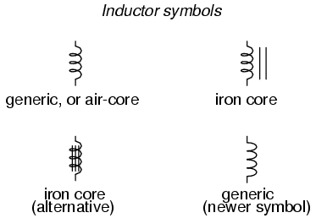
Inductor
http://www.allaboutcircuits.com/

Slide 12
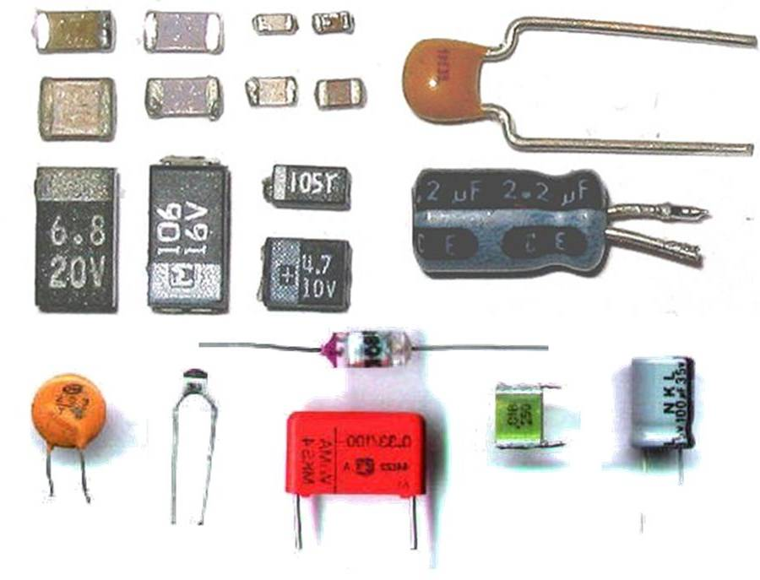
Capacitor
http://www.mp-estore.com/

Slide 13
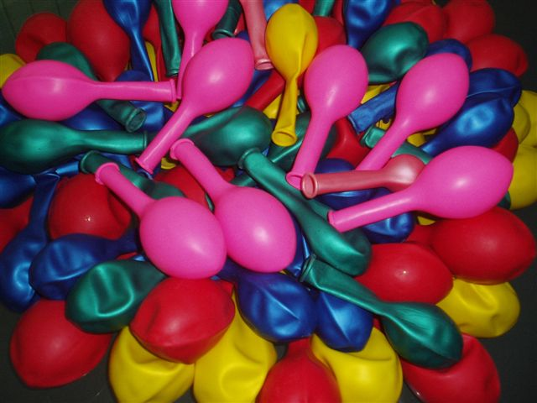
Capacitor
http://www.kdiballoon.com/

Slide 14
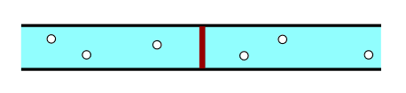
Capacitor
http://en.wikipedia.org/wiki/User:Sbyrnes321

Slide 15
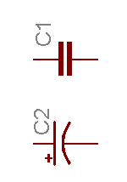
Capacitor
http://gaussmarkov.net/

Slide 16
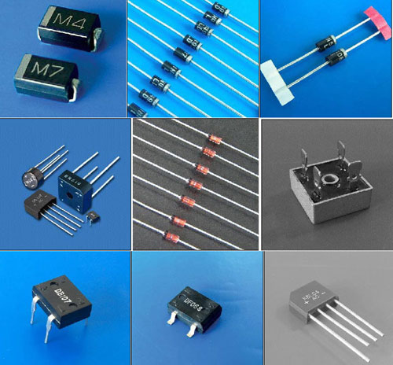
Diode
http://adamsun.en.made-in-china.com/

Slide 17


Diode
http://www.rijksoverheid.nl/ministeries/ienm/

Slide 18

Diode
https://ece.uwaterloo.ca/~dwharder/

Slide 19
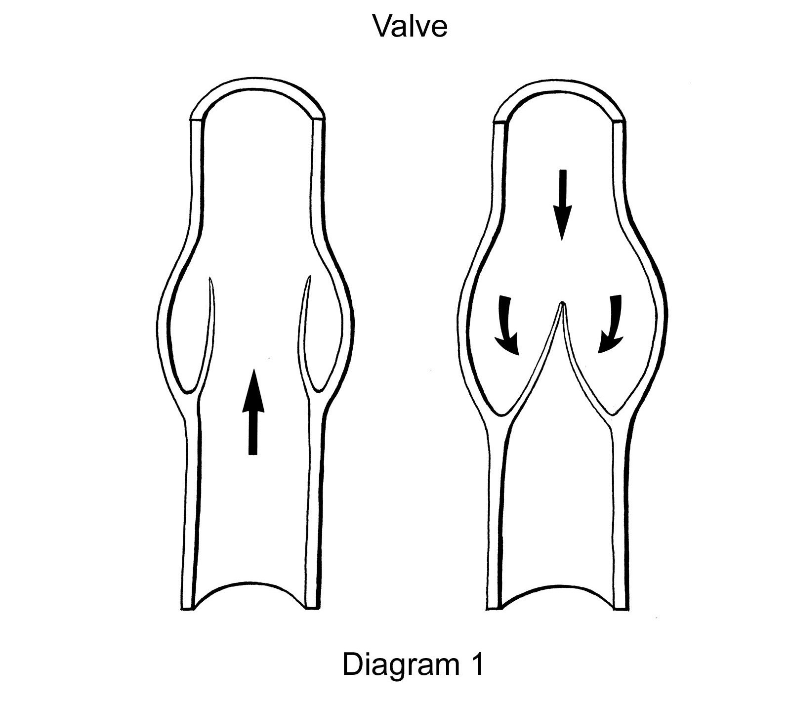
Diode
http://www.wsiat.on.ca/english/mlo/venous.htm

Slide 20
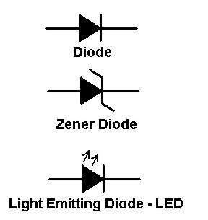
Diode
http://cdselectronics.com/

Slide 21
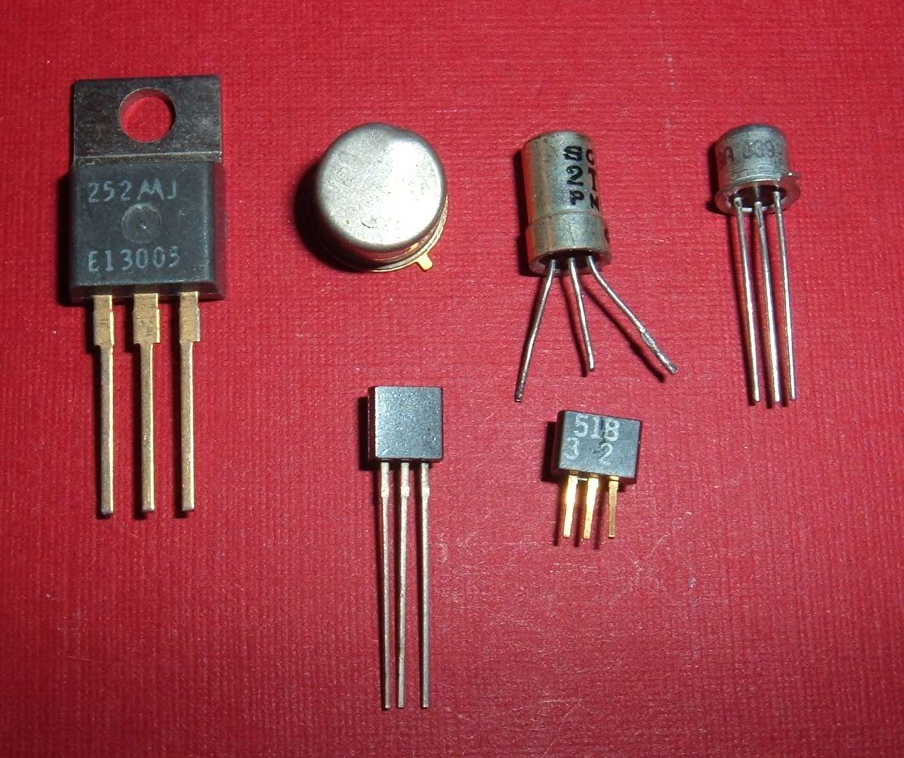
Transistor
http://www.std.com/~reinhold/

Slide 22
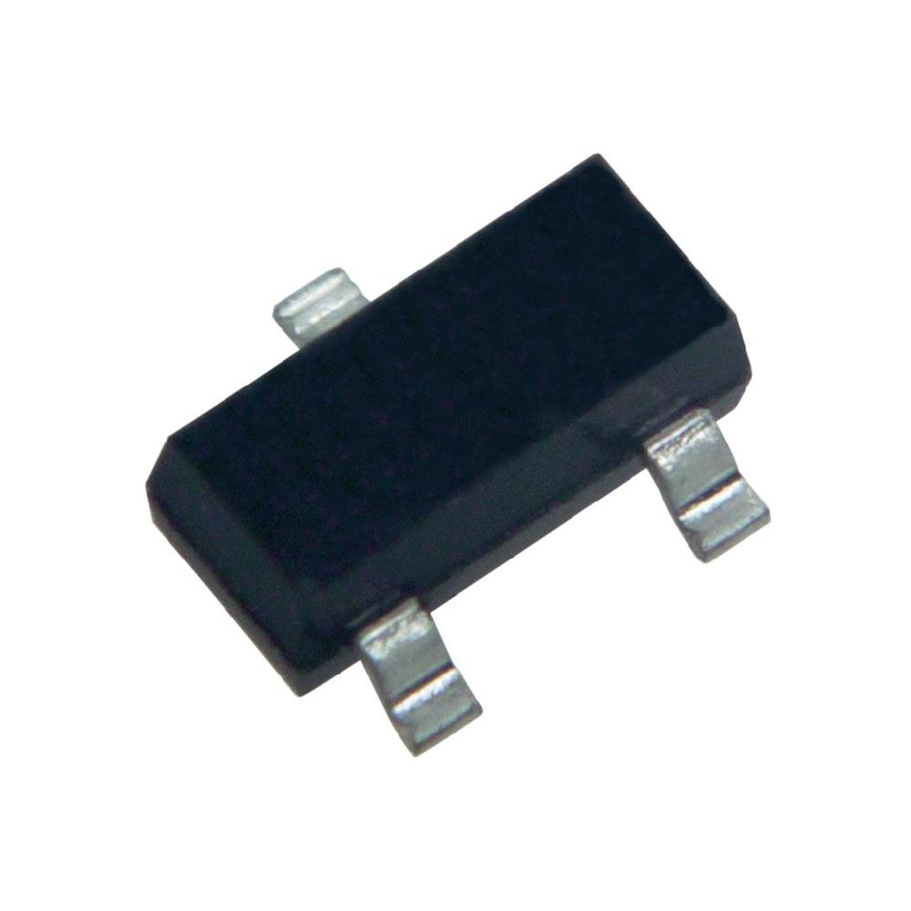
Transistor
http://www.conrad.com/ce/en/product/150901/

Slide 23
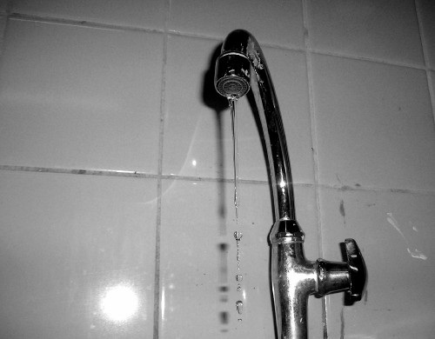
Transistor
http://www.robkomen.nl/

Slide 24
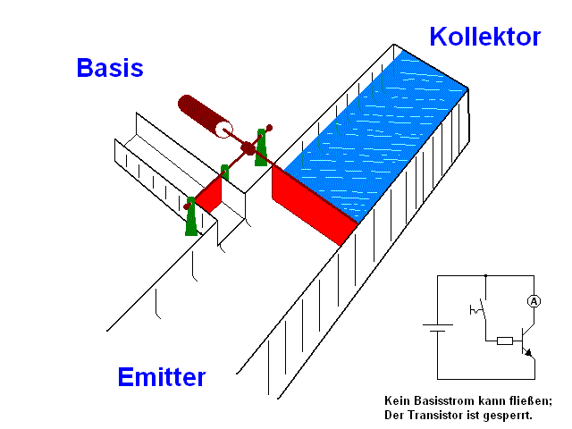
Transistor
http://de.wikipedia.org/wiki/Benutzer:Quark48

Slide 25
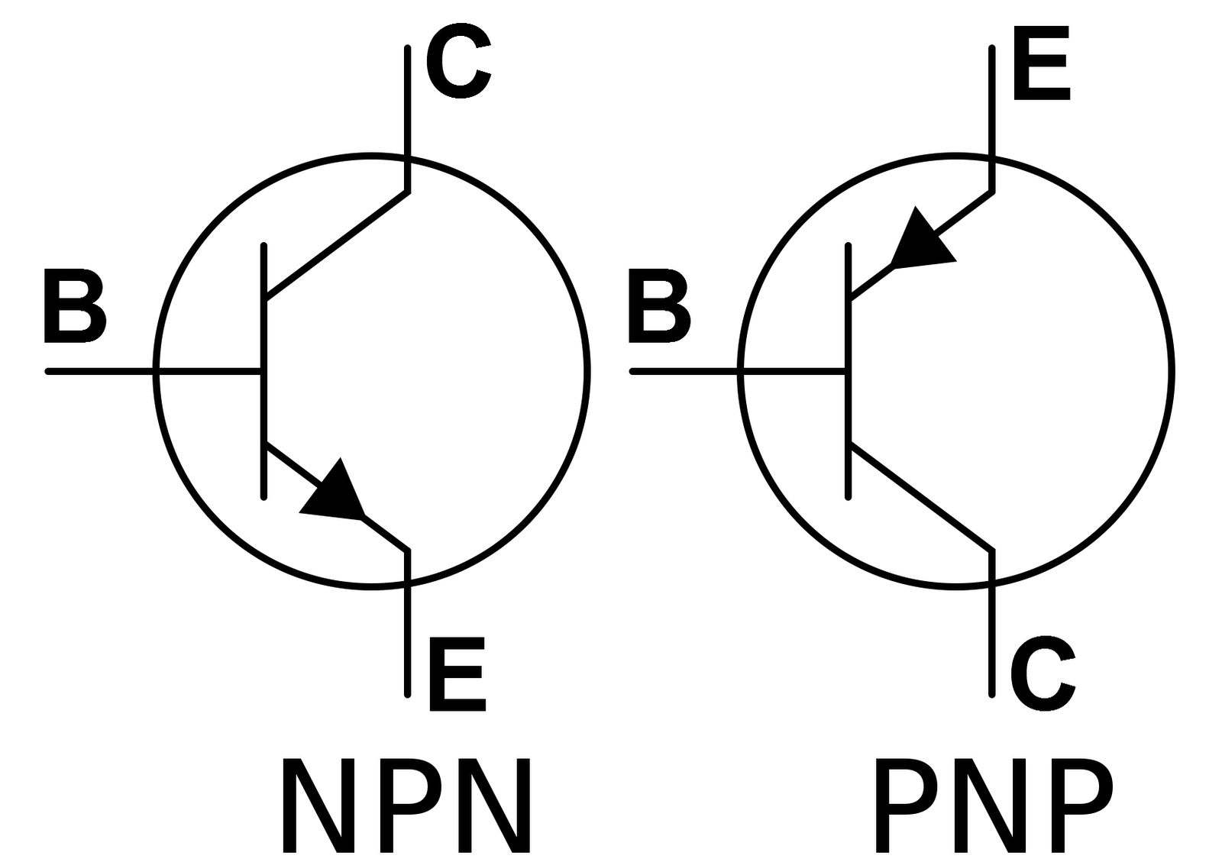
Transistor
http://salviusrobot.blogspot.nl/

Slide 26
Questions?
2013 Anne Jan Brouwer

